Slide 1
Unlocking Shared Housing Supply in Canada:
Happipad
Final Presentation
Yuzhu Han, Foster Lockerbie, Jingran Zhao & Litao Zheng

Slide 2
Contents
01.
Team & Happipad Overview
02.
Project Details
03.
Results
04.
Conclusion

Slide 3

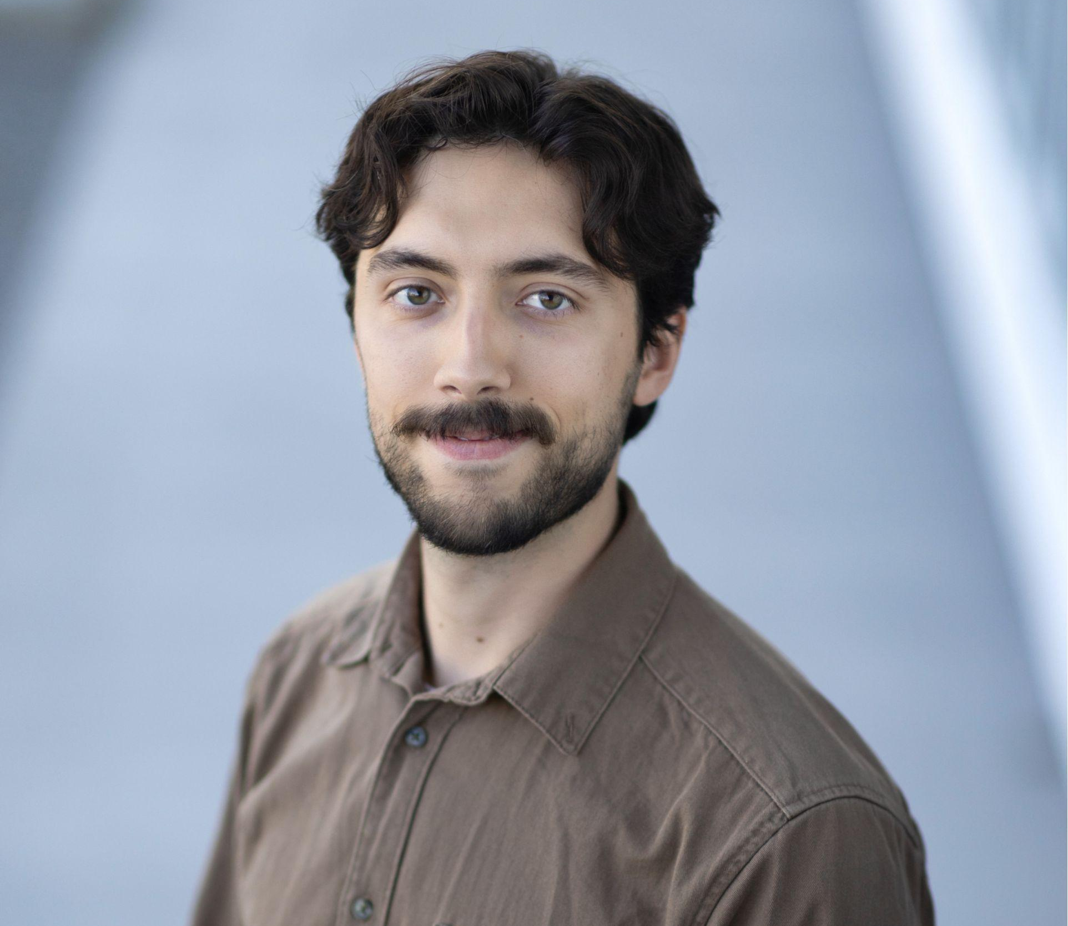


Our Team
Yuzhu Han
Foster Lockerbie
Jingran Zhao
Litao Zheng
Background in statistics and urban planning
Background in psychology (statistics focus)
Background in information management
Background in Mathematics and Statistics
Notes:
Diverse mix of background
approach the project from multiple perspectives

Slide 4
What is Happipad?
Housing platform geared toward “unlocking underutilized housing”. Focused on providing affordable homes for seniors, refugees, and students.
Matches landlords with renters based on comprehensive profiles with list of habits and preferences.
Notes:
As we are all aware, housing in Canada has become increasingly unaffordable and difficult to maintain for many people. Various strategies have been implemented to tackle this problem, both from legislation and private companies.
This is where Happipad looks to provide a solution. Happipad is a rental listing website that emphasizes renter and landlord compatibility. They aim to unlock underutilized housing by encouraging landlords to rent out unused bedrooms in their home, which is more appealing when landlords know more of the personality of their prospective renters. To achieve this, they require all clients to have comprehensive profiles regarding their interests and preferences (such as how often they like to cook, how often they like to have guests over, etc.). Happipad states there are over 12 million empty bedrooms across Canada, which could be a significant source of housing in a time when our country has a high demand

Slide 5
Research questions
Happipad
Can we effectively represent the housing demand and trends through dashboarding?
Can we predict which home listings will be rented?
Can we predict the appropriate price for rental listings?
Can we use any large language models to improve our predictive modelling?
Notes:
Happipad was not currently utilizing all of their data and applying machine learning methods and thorough data analysis, so they tasked us with creating a project that would help them to accomplish this
We determined that a series of dashboards could help them understand their clientele and the impact of their business
Happipad also asked for a model to predict which homes listed on their site would be rented
To enhance this, we wanted to create a model that could predict the appropriate price for a home based on its features
Users could be notified if their listing falls outside a certain window that contains the predicted price of the home
Keeping homes within an appropriate price range would ideally help hosts rent their properties more easily and keep prices affordable for renters
Lastly, since there are multiple open-text fields in the dataset, we decided to see if we could use natural language processing techniques to make use of this information and improve our analyses

Slide 6
Deliverables
Happipad
Dashboards
Predictive Modelling
Final Report
Property and renter monitoring:
Property overview
Renter overview
Two Versions: Dash and Tableau
Predicting price of rental spaces based on home features
Formal project report including:
Project research questions
Methods
Predictive modelling results and analysis
Dashboard explanation
Using NLP to inform price predictions based on text responses
Notes:
We decided to create two dashboards: the renter overview and property overview, which would give Happipad insights into both sides of their user base
We then wanted to conduct data modeling to predict home prices, with the assistance of NLP analysis of the unstructured text within the data
Lastly, we would provide the final report along with our methodologies and code, that would allow Happipad to continue feeding new information into our
Dashboards and data analysis pipelines to leverage their data and understand business needs moving forward

Slide 7
Data Overview
Happipad
Renters Dataset
Hosts Dataset
Desired lease term
Budget
City
…
Location
Preferred gender of roommates
Disabilities
…
Properties Dataset
Contracts Dataset
Rent price
Property locations
Furnishing details
…
Monthly price of rent
Lease term
Location
…
7
Notes:
We were provided with four datasets in the form of CSV files:
The contracts dataset includes information about rental agreements created between hosts and renters (such as lease term and rent price)
The properties dataset has information about home listings on Happipad, such as the asking rent price, property locations, furnishing details, and brief descriptions of the properties
The renters dataset includes information about renters such as the city they are looking in, their budget, and the lease term they desire
The hosts dataset includes requirements and preferences of living styles from hosts and the locations of hosts

Slide 8
Data Cleaning
Investigate outliers
determine which values are considered outliers and if they should remain in the dataset
Remove test properties and listing
Standardize columns (postal code, address, city, province)
Binarize columns that contain multiple values
Convert data types
Happipad
Notes:
Before conducting analysis, we performed several data cleaning steps to ensure accuracy and consistency across datasets.
First we investigate outliers, specifically for numerical variables. We set cutoff points for rental prices from $50 per month to $3000.
For other specific data points we thought may be outliers, we consulted with Happipad to make a determination
Remove test properties and listing
Binarize columns that contain multiple values
We also had to convert columns to the proper data type for our analyses and standardize responses such as postal codes

Slide 9
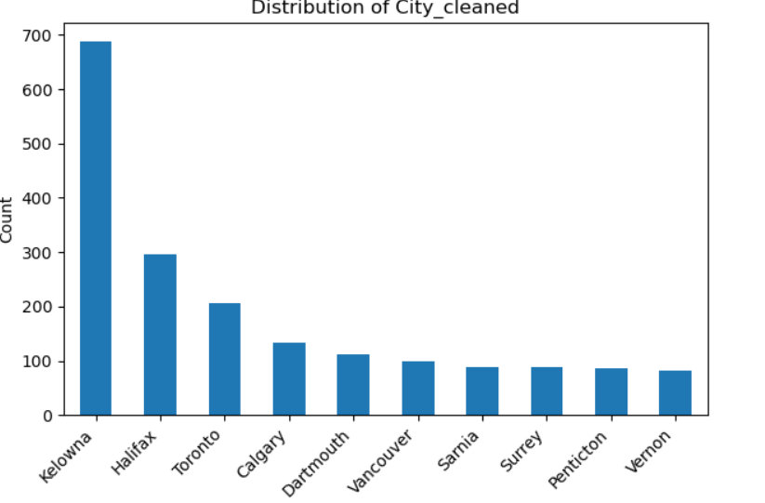
EDA - Hosts
Happipad
Notes:
Now move to the EDA section. We will share a few key insights from our initial exploration of the data.
Starting with the hosts dataset, we examined hosts’ geographic distribution. Kelowna stands out with the highest number of hosts, which is around 700. Halifax comes next with just over 300 hosts, followed by Toronto, Calgary, and Dartmouth.

Slide 10
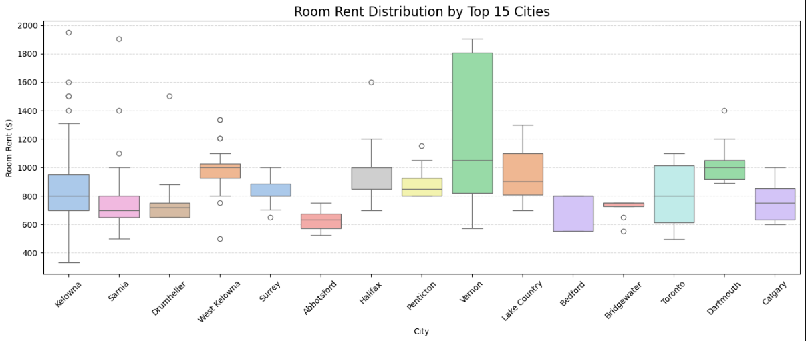
EDA - Contracts
Happipad
Notes:
Here are the top fifteen cities with the most rental contracts, and the distribution of their rental prices
This shows that Happipad is tapping into very specific markets
We would not expect a place like Drumheller to be a top rental location as it does not have a high population or many rental buildings,
suggesting that Happipad may be successful in making unused bedrooms available for renting

Slide 11
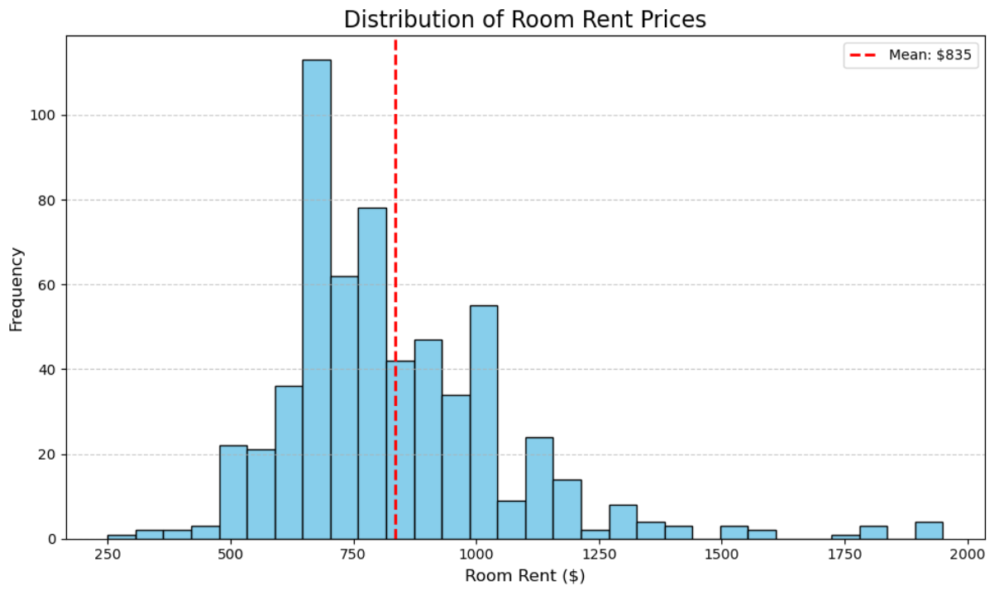
EDA - Contracts
Happipad
Notes:
This is a distribution of room rent prices in the contracts dataset
The mean room price is $835, with a relatively normal distribution with a positive skew
This mean price is also notably lower than the average price for a room in shared accommodations in Canada which is $1010, which is an indication that Happipad may be succeeding in providing a more affordable form of housing than average

Slide 12
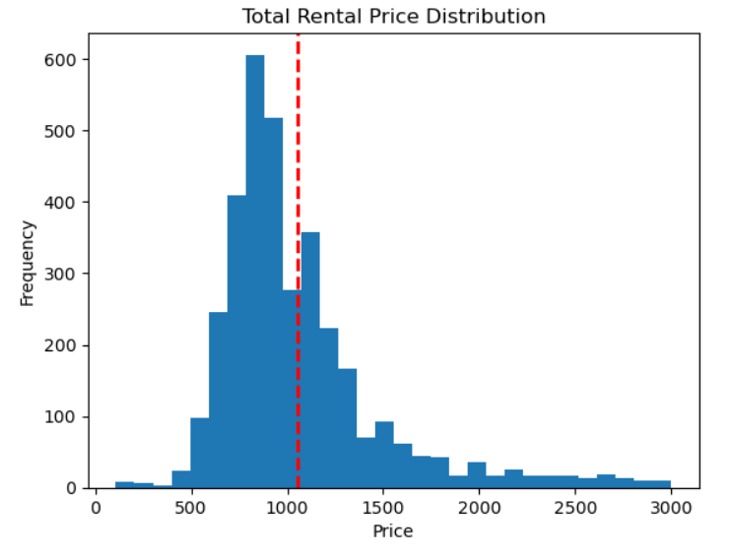
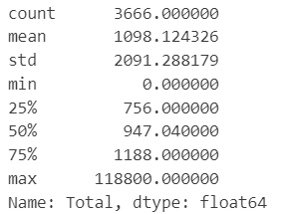
EDA - Properties
Happipad
Notes:
Next is the EDA for the properties dataset. This is a statistical table of the rental price for all the properties on the left. The min and max values show that there are definitely outliers. Then we filter the rental price with min 50 and max 3000 to remove potential outliers. The distribution is relatively a bell shape but a bit right skewed with a mean of $1054, which is higher than the mean price in the contracts dataset

Slide 13
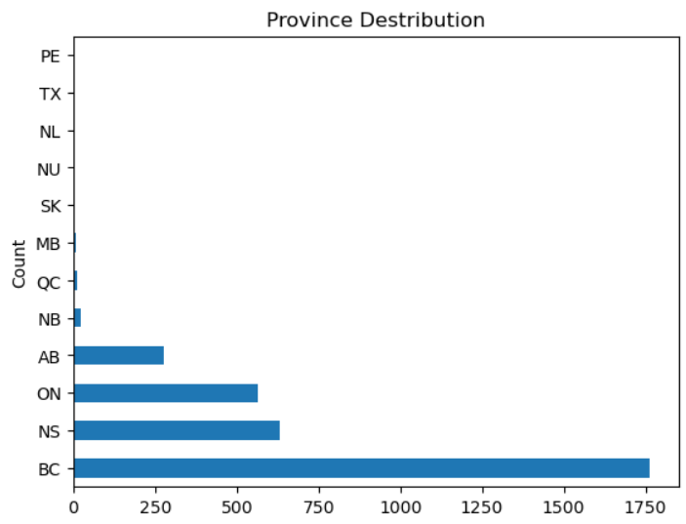
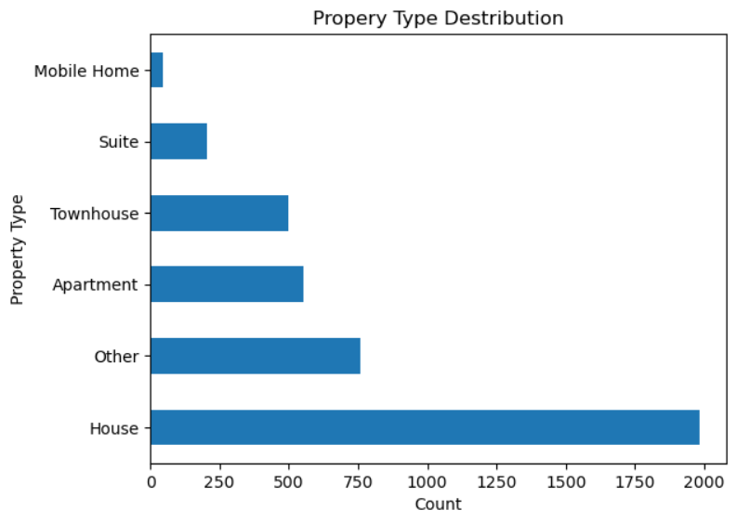
EDA - Properties
Happipad
Notes:
We can gather other insights into property dataset from these two plots. The plot on the left displays the distribution of properties by province. The majority are located in British Columbia, followed by smaller proportions in Nova Scotia, Ontario, and Alberta. Only a few properties are in other provinces.
The plot on the right shows the distribution of property types. Around half of the listings are houses, suggesting that most hosts are renting out rooms within houses on happipad.

Slide 14
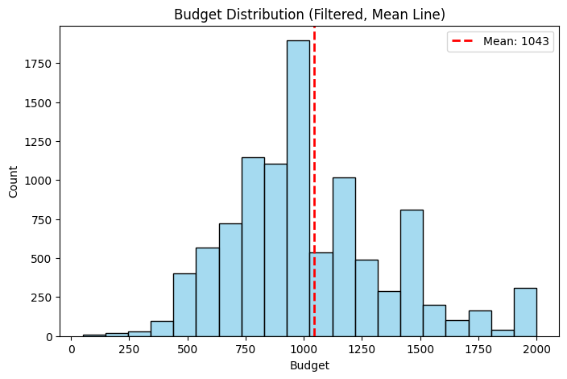
EDA - Renters
Happipad
Notes:
Renters dataset is also a main dataset we got. Exploring it helps us understand renters’ behavior better.
This plot shows the budget distribution - how much people are willing to pay for properties.
We've already removed outliers, like values less than 50 or above 3,000.
The mean budget is 1043, which is higher than the mean price in contract dataset.

Slide 15
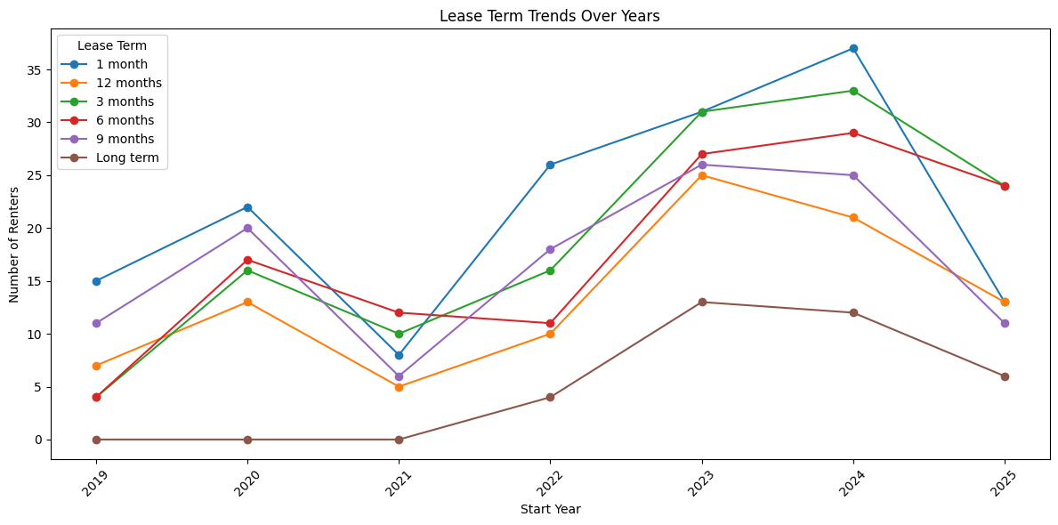
EDA - Renters
Happipad
Notes:
This line chart shows the lease term trends from 2019 to 2025. Most of the time, people preferred a 1-month lease. But in 2021, 6-month leases became more popular, and in 2025, 3-month leases and 6-month leases were the most common.

Slide 16
Results:
Predictive Modelling
- price predictions
Happipad
Model Name | RMSE | Relative Error
XGBoost (target encoding) | 137.41 | 16.46%
XGBoost (one-hot encoding) | 141.89 | 16.99%
Random Forest | 133.60 | 16.00%
LightGBM | 137.42 | 16.46%
Random Forest + NLP | 140.43 | 16.82%
Notes:
Onto the predictive modeling of the price of the homes based on their features
We chose a variety of models to predict the home prices, based on the existing literature regarding home sale price predictions
Although home sales are different from home rental prices, many of the same features are included in the analyses, so we felt these models would still be appropriate
We judged model performance based on root mean-squared error or RMSE
Two iterations of XGBoost were created.
Target encoding was used for the city variables in one trial of XGBoost to keep the number of dimensions lower and prevent overfitting because
We have over 70 different cities, then the same model was run with one-hot encoding of the city variable
Overall, random forest performed the best
These models will likely improve over time, but they have utility as they could detect if a home price is vastly outside of reasonable range
The random forest performed slightly worse after combining it with the NLP results (which we will discuss shortly)
However, this is likely due to a small sample size and it will improve in the future

Slide 17
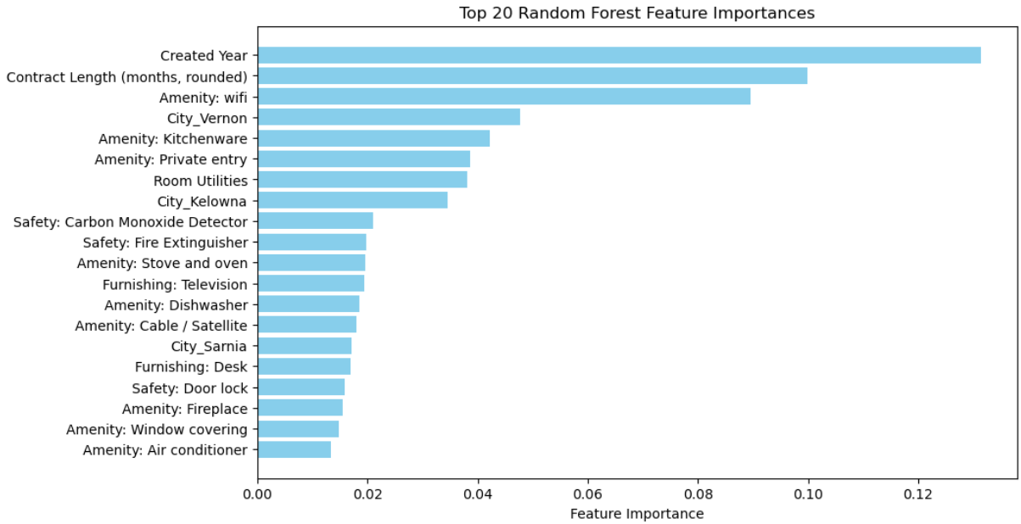
Results:
Predictive Modelling
- price predictions
Happipad
Notes:
After selecting the most accurate model, we determined which features were most important to this model
Unsurprisingly, the year the contract was made was the most important factor
Rounding out the top three most important factors were the length of the contract and the inclusion of wifi

Slide 18
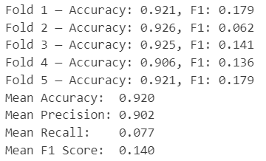
Results:
Predictive Modelling
- Rental Likelihood Classifier
Happipad
Target variable: a binary column indicating whether the property has a rental record in the contracts dataset
5-fold Random Forest:
Predict
 | 0 | 1
0 | 3693 | 4
1 | 321 | 27
True
Notes:
In addition to predicting rental prices, we also tried to understand rental outcomes
Using the properties dataset, which includes homes that were rented before and those that were not, we performed predictive modeling to see if we could predict which homes would be successfully rented based on their features
the target variables is…
We applied a 5-fold random forest classifier…
Although the average accuracy and precision are high, the low F1 score indicates poor overall classification performance. This is largely due to the imbalance in the dataset, which contains over 4,000 properties, but only around 360 of them have been previously rented. As we can see in the confusion matrix, the model makes a lot of false negatives for class 1, meaning that many properties with a rental record in the contracts dataset were incorrectly classified as not rented.

Slide 19
NLP - Ollama
Happipad
Ollama is a command-line platform for running large language models (LLMs) on local computer for offline text generation and analysis
natural language processing tasks such as summarization, text classification, etc.
Mistral:
Good balance between accuracy and speed
Run efficiently on local hardware
Notes:
Moving beyond the predictive modelling, we tried to implement natural language processing model to extract some information from the unstructured proterty titles and descriptions to add more information for our predictive analysis and make the best use of the provided dataset. The tool we choose is ollama, which is…
provides a flexible and private environment for natural language processing tasks such as summarization, text classification, etc.
Mistral: efficient and open-source LLM
…lower requirements on the computer’s capability

Slide 20
NLP - Ollama
Happipad
Expected output columns:
number_of_people: number of people mentioned in the description
bedrooms: how many bedrooms for rent
pets_allowed: whether pets are allowed on the property
property_size: the size of the property
shared_spaces: a list of shared spaces in the rental listing
bathroom_type: the bathroom would be shared or private
nearby_amenities: a list of nearby amenities, such as bus stop
unique_features: unique features of the property
Notes:
Here are the columns we tried to extract from the text data
Some of the variables are data features that Happipad would like to collect in the future, such as number of people, bedrooms, pets, and bathroom type.
We also added two more variables, the nearby amenities and unique features of the property
They are also important for rental listing and can make the dataset more comprehensive

Slide 21
NLP - Ollama
Happipad
Input prompt 1:
Return a JSON object with:
- Number Of People (how many people the space is for or referenced)
- Number Of Pets (how many pets are mentioned)
- Property Size (e.g., small, medium, large, unknown)
- Shared Spaces (e.g., kitchen, living room)
- Bathroom Type (shared or private)
- Nearby Facilities (e.g., bus stop, store)
If the information is missing, return "unknown".
Notes:
For mistral model, the key factor for tuning is the input prompt
It does Not specify the expected output format and value options for each variable

Slide 22
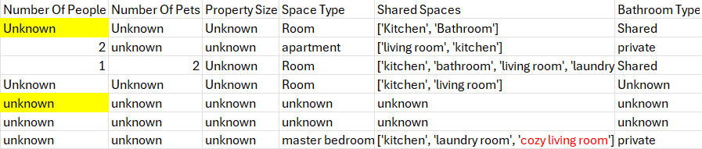
NLP - Ollama
Happipad
Example output 1:
Notes:
Data is not clearly unstructured and is not helpful for our predictive modelling
For example, the capitalization of “unknown” is inconsistent, and there are still some non-standardized text strings in the output

Slide 23
NLP - Ollama
Happipad
Input prompt final:
Schema:
{(
"number_of_people": "integer or 'unknown'",
"bedrooms": "integer or 'unknown'",
"pets_allowed": "true, false, or 'unknown'",
"property_size": "'small', 'medium', 'large', or 'unknown'",
"shared_spaces": "comma-separated string or 'unknown'",
"bathroom_type": "'private', 'shared', or 'unknown'",
"nearby_amenities": "comma-separated string from [bus, store, recreation centre/pool, school and university] or 'unknown'",
"unique_features": "semicolon-separated string or 'unknown'"
}}

Slide 24
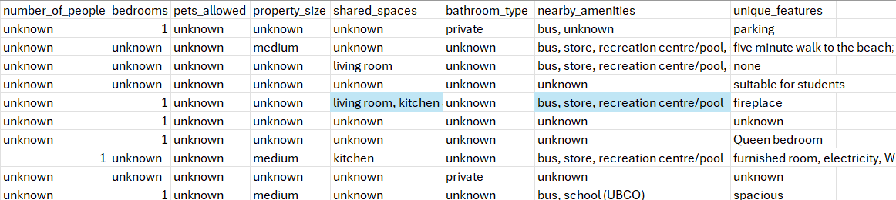
NLP - Ollama
Happipad
Example output final:
Notes:
Data is more structured and standardized
No capital letters in unknown
We can also see the Standardized and meaningful value in shared_spaces and the nearby_amenities columns (as highlighted cells

Slide 25
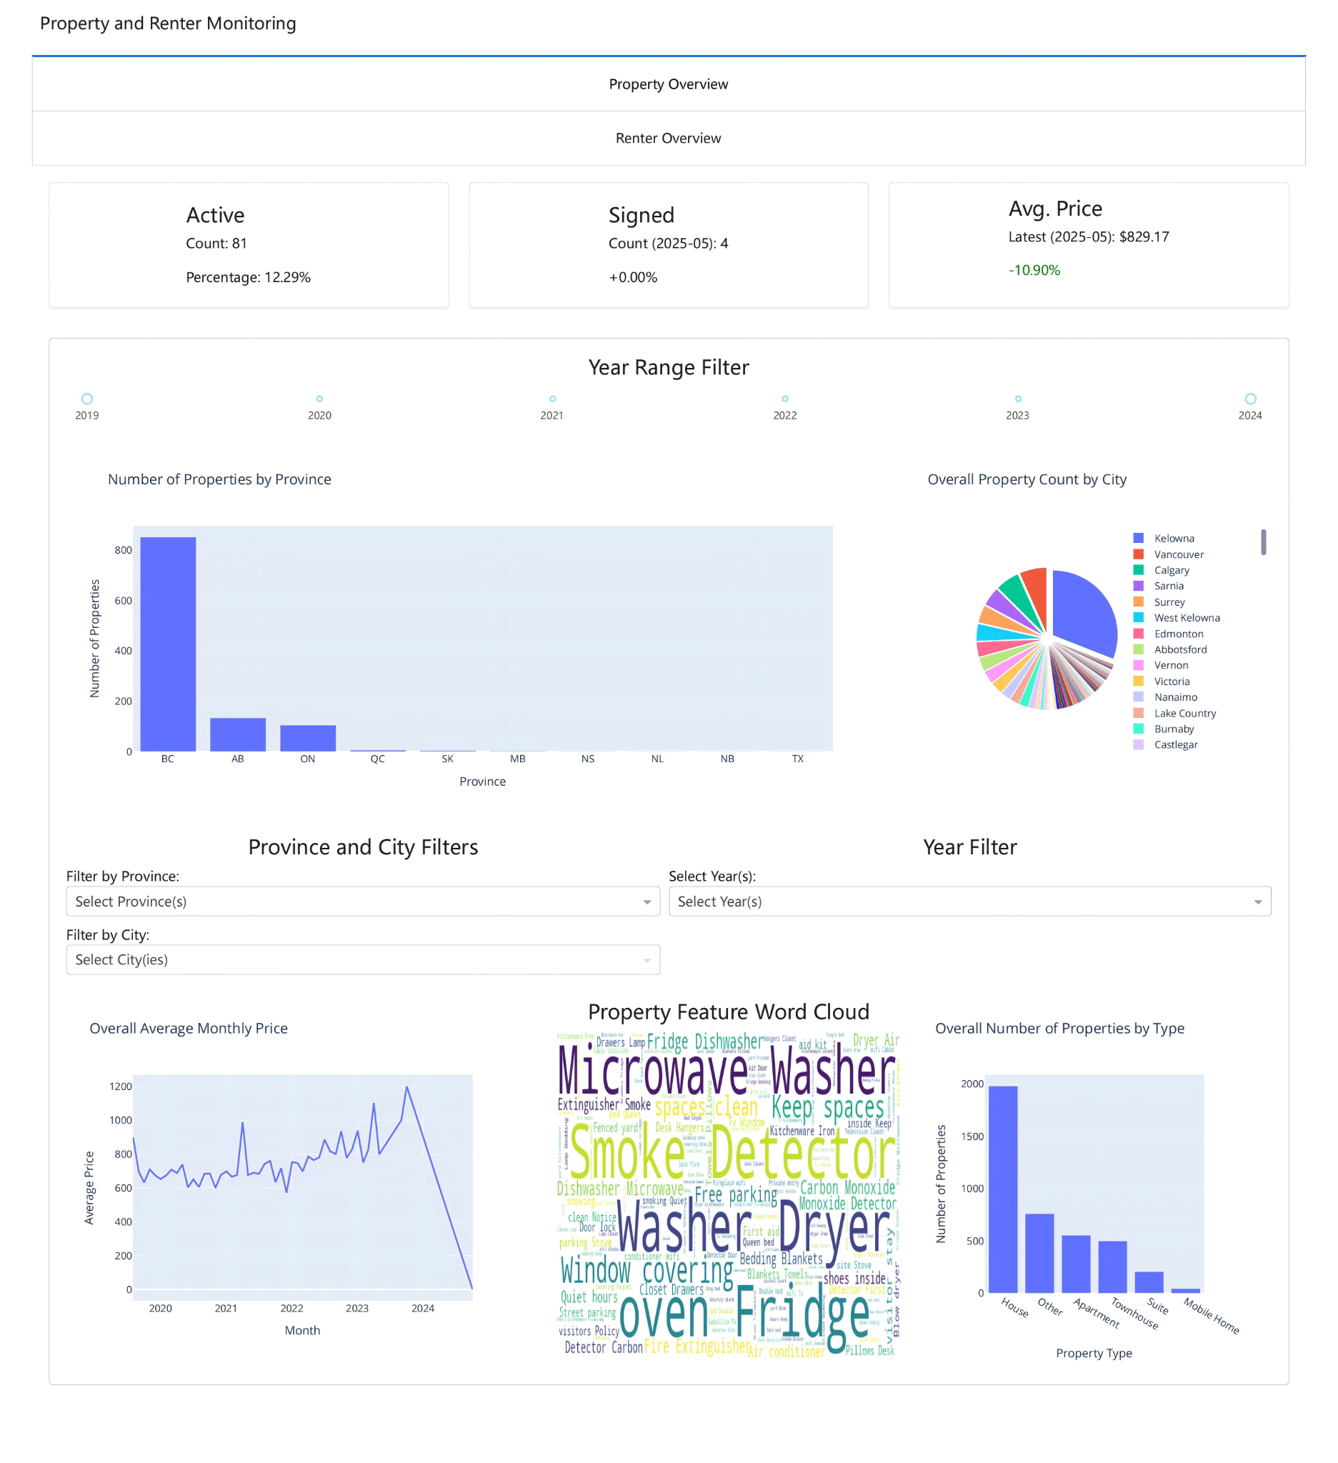
Dashboard(Dash):
Property Overview
Happipad
Property Status
Geographical Distribution
Property Characteristics
Notes:
To detect the trends of key indicators, we delivered two dashboards to our clients, which are property overview and renter overview.
This is the Property Overview, which covers three main areas — rental status, geographical distribution, and property characteristics.
This is a full screenshot of property overview page

Slide 26
Dashboard(Dash):
Property Overview
Happipad
Property Status
Location Distribution
Notes:
I will go through it from top to bottom
At the top, those values shows the rental situation such as the number of active properties, the number of signed contracts and the average monthly rental price. Those can alert whether there is an anomaly such as a sharp drop in price. We can find the causes and solve it.
In the middle, we can analyze the location distribution with a bar chart showing the distribution by province and a pie chart showing the distribution by city. Both of them can be controlled through a year filter.
Also, if we click on a bar in property distribution by province, the pie chart on the right will show the distribution by cities among that province.

Slide 27
Dashboard(Dash):
Property Overview
Happipad
Other Features
Notes:
At the bottom, other important features are shown here. We can see the price trend over years, the most common property amenities and the property type distribution.
Three filters allow our clients to select multiple provinces, cities and years. So, we can compare the price trend and property type distribution from different provinces or cities.

Slide 28
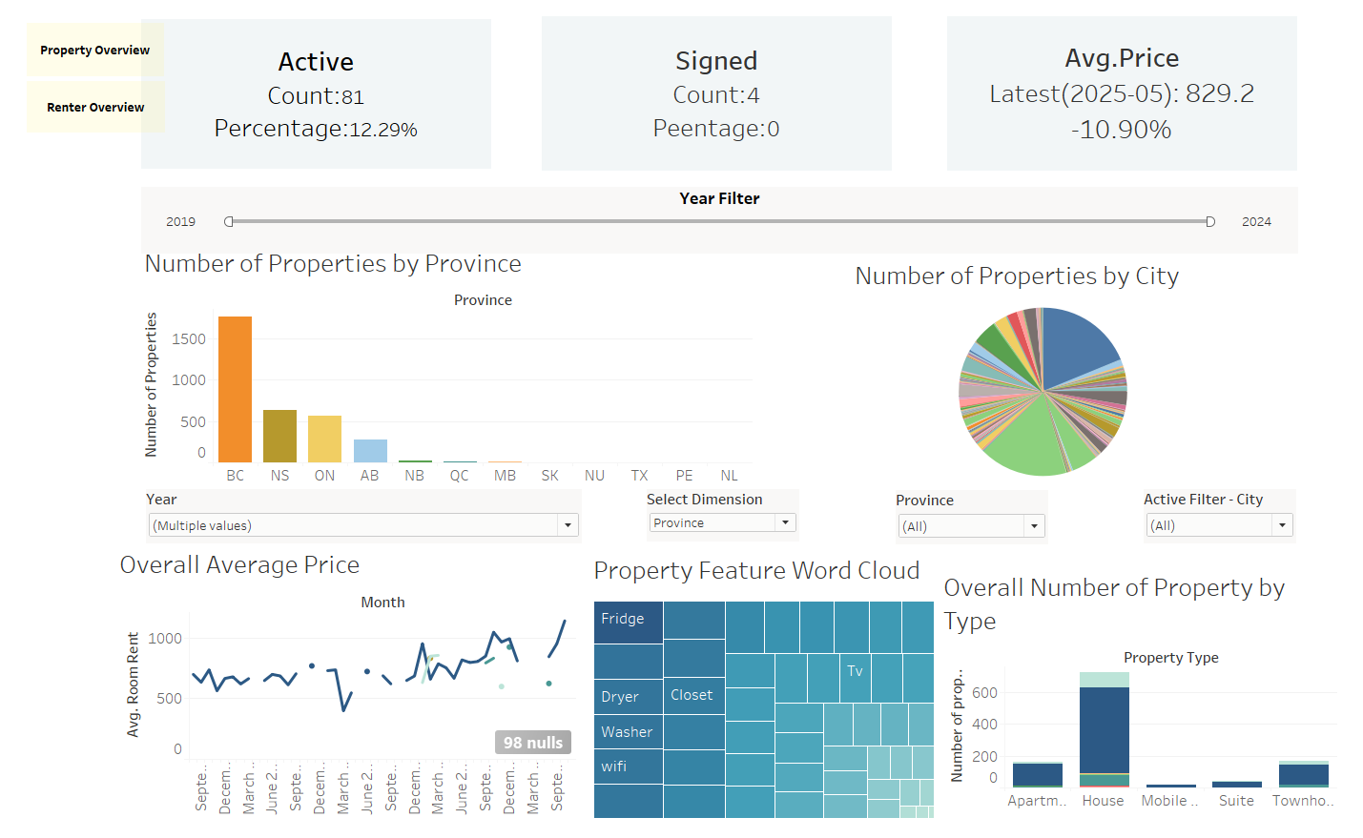
Dashboard(Tableau):
Property Overview
Happipad
Notes:
We initially made our dashboards in Dash, as Happipad prefers to use Python, but we also recreated our dashboards in Tableau to provide another option that is more user-friendly and has more stylistic options

Slide 29
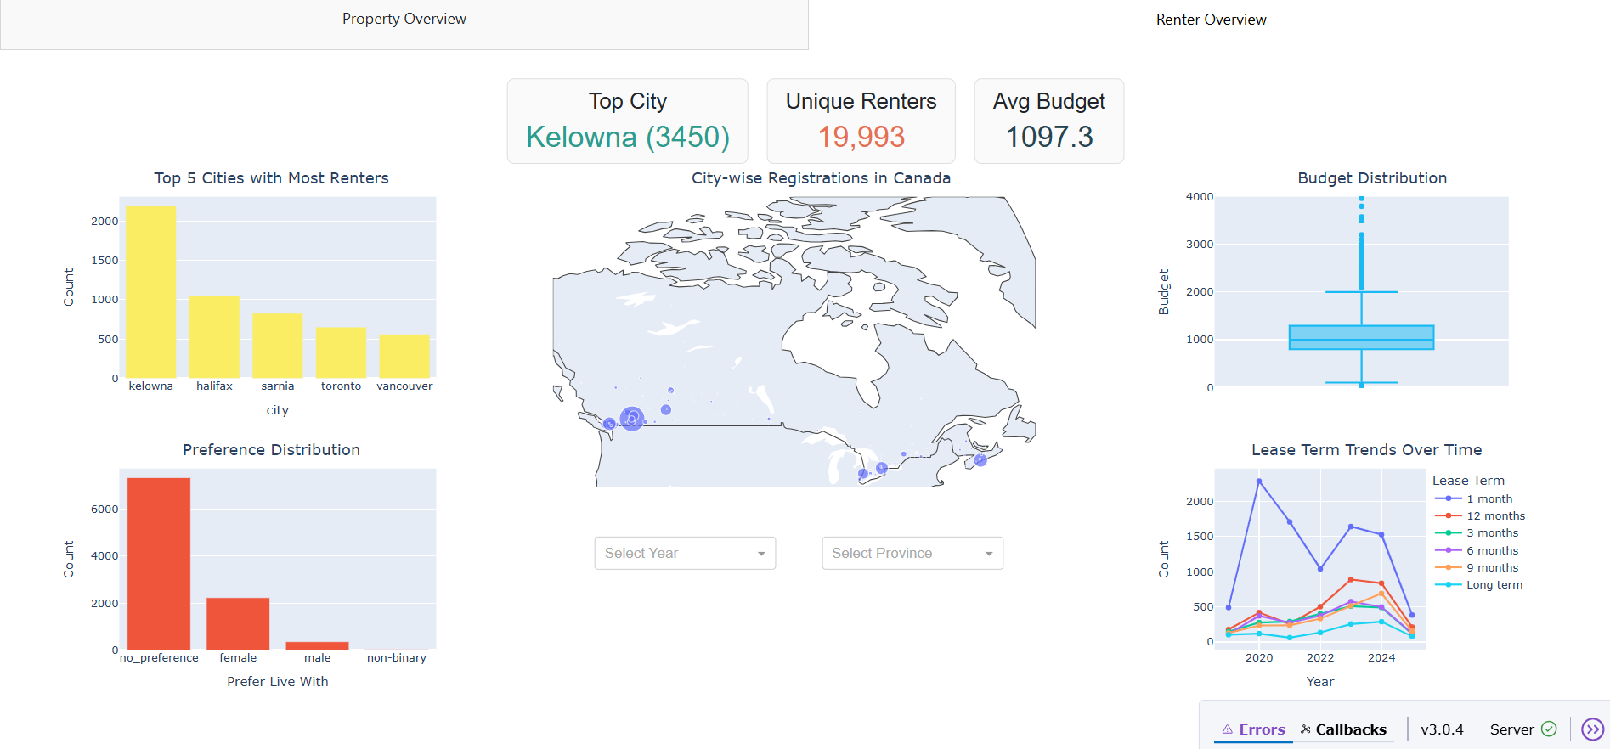
Dashboard(Dash):
Renter Overview
Happipad
Basic Information card:
Top City, Unique Renters, Average Budget
Canada map showing renter distribution
Budget Distribution
Lease term distribution
Filter dropdowns:
Year, Province
Notes:
Here comes the second page of our interactive dashboard, designed to visualize renter trends and market dynamics across Canada. At the top, we can see some key statistics: The number of unique renters, the most popular city, also the average budget of all renters per month. The central map shows renter distribution across Canadian cities, highlighting by demand hotspots of popular cities. On the left, we can see the top 5 most popular cities for renters. Move to the left bottom corner, we can see the gender preferences of renters for their expected roommates. On the right, the budget distribution shows most renters plan to spend below $2,000 per month, and the lease term trends indicate 1-month and 1 years leases are the most common choices over time. Filters at the bottom allow users to explore the data by province, year, and lease term, offering interactive insights.

Slide 30
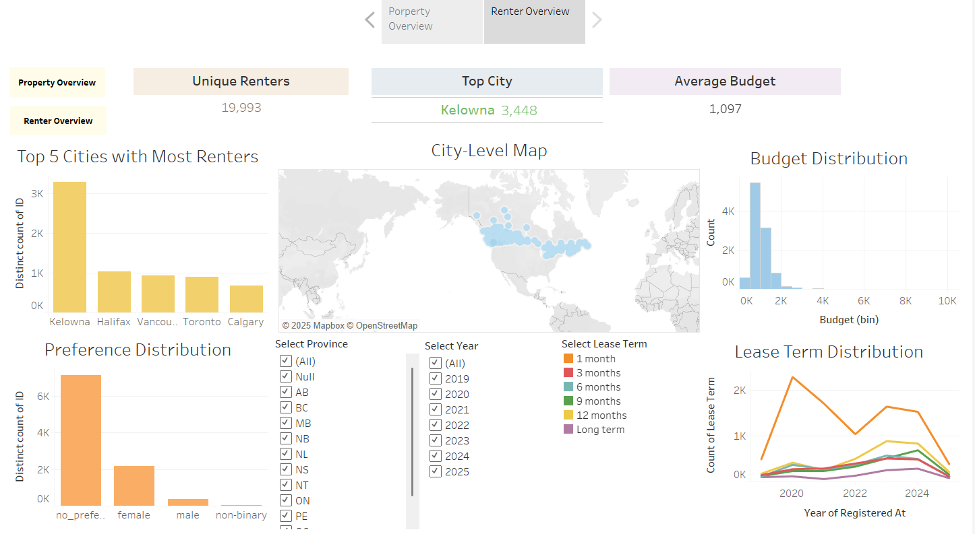
Dashboard(Dash):
Renter Overview
Happipad
Notes:
Here is a screenshot of our renters dashboard that we recreated in Tableau, as we did for the properties overview.

Slide 31
Conclusion
Happipad
Two dashboards (Property and Renter Overview):
Help Happipad monitor business
Help Happipad understand their clientele
Modelling Framework
Ollama with Mistral
Future works:
Monitor model performance as dataset grows
Build a streamlined process to continuously update the dashboard
Notes:
In conclusion, we have provided Happipad with two dashboards that will help them to monitor their business needs and their clientele
We have also provided them with a modeling framework that they can incorporate into their data pipeline to make use of their data
In the future, we could continue to monitor the model performance as the dataset grows to ensure they improve, or build a streamlined method for Happipad to continuously update the dashboards we built
We implemented Ollama with mistral for information extraction from the property title and description, which can be used as a guide for them to implement LLMs to get the information from the text to fulfill the newly introduced variables in their data
Monitor model performance as dataset grows
Build a streamlined process to continuously update the dashboard
Thank you to Happipad for providing us with the opportunity to complete this project
Thank you also to Scott for his assistance throughout the project, helping us overcome unexpected hurdles

Slide 32
Acknowledgement
Happipad
MDS Capstone
Dr. Scott Fazackerley
Notes:
Thank you to Happipad for providing us with the opportunity to complete this project
Thank you also to Scott for his assistance throughout the project, helping us overcome unexpected hurdles

Slide 33
Thank you!

